Slide 1

AI Factory Austria AI:AT
Foundations of Trustworthy AI
Cornelia Reiter, Rodrigo Conde-Jimenez; Scientists; Regulatory and Ethics
Krisztina Rozgonyi
Senior Scientist; Legal and Policy

Slide 2
AI Factory Austria AI:AT - PUBLIC
Consortium
Disclaimer:
The speakers are solely sharing their personal experiences. Therefore, this free seminar is not a substitute for professional/legal advice.
Beneficiaries
Affiliated Entities

Slide 3
Why do we need AI Factory Austria?
Sovereignty
Ethics and Trustworthiness
Connecting the Ecosystem

Slide 4
Trustworthy AI in the European (EU) approach
Trustworthy AI must be lawful, ethical and robust
LAWFUL | ETHICAL | ROBUST
Complies with binding law and regulation | Respects values and addresses impacts beyond minimum compliance | Operates safely and reliably in its technical and social context
AI Act, GDPR, fundamental rights and sectoral law | Fairness, human autonomy, societal consequences and competing values | Accuracy, security, resilience and appropriate human oversight

Slide 5
Why Europe needs common rules for AI
AI can influence access to jobs, loans, education and public services. Harm can be difficult to detect or challenge, while the same system may operate across many countries.
GLOBAL PRINCIPLES
International frameworks set out widely shared principles such as safety, transparency and accountability. Most do not themselves create detailed, enforceable duties for companies using AI in Europe.
EXISTING LAWS
Data protection, consumer protection and anti-discrimination law already apply. They address important harms, but they do not provide one framework for managing AI risks throughout a system’s lifecycle.
CROSS-BORDER SYSTEMS
Different national AI rules would make protection uneven and compliance difficult. Common EU rules provide the same baseline across the internal market.
CLEAR RESPONSIBILITY
The AI Act specifies what providers and users of regulated AI systems must do. Requirements become stricter when the possible harm to people is greater.
The AI Act turns broad principles into a common European safety framework with enforceable responsibilities.
Notes:
Sources:
European Commission, AI Act: https://digital-strategy.ec.europa.eu/en/policies/regulatory-framework-ai
Regulation (EU) 2024/1689, especially Articles 1, 6, 9–15 and 16–27.
OECD AI Principles, updated May 2024: https://oecd.ai/en/ai-principles
Council of Europe Framework Convention on Artificial Intelligence and Human Rights, Democracy and the Rule of Law: https://www.coe.int/en/web/artificial-intelligence/the-framework-convention-on-artificial-intelligence

Slide 6
When to care about the AI Act?
Placing on the market/commissioning
in the EU
Market principle
Use of results
in the EU
Settlement principle
Impact Principle
Established players in the EU

Slide 7
What is "artificial intelligence"?
AI system:¹
  machine-based system,
  designed to operate with varying levels of autonomy,
  may exhibit adaptiveness after deployment
  for explicit or implicit objectives, infers, from the input it receives, how to generate outputs such as predictions, content, recommendations, or decisions,
  can influence physical or virtual environments.
1: Sec 3 Num 1 AI-Act; European Commission (EC), Commission Guidelines on the
definition of an artificial intelligence system established by Regulation (EU) 2024/1689 (AI Act), 06.02.2025.

Slide 8

How do AI Models relate to AI Systems?
AI System
(think of it as a fully usable system – like a whole car)
AI Model
(think of it as one essential part – like the engine of a car)
Vgl. Almada, Law & Compliance in AI Security & Data Protection, 12.2024.
Bildquelle: Le Chat

Slide 9
When is the AI Act not applicable?
The AI Act does not apply, among other things, to:
...
AI systems or AI models that are developed and put into operation exclusively for scientific research and development;
AI systems provided under free and open source licenses, unless they are Prohibited AI Systems, High-Risk AI Systems, or Art 50 AI Systems;
…
1: Art 2 Artificial Intelligence Regulation.

Slide 10
The AI Act in practice
The Act uses a risk-based approach. Many ordinary uses face no additional AI Act duties, while systems that can seriously affect people require stronger safeguards.
UNACCEPTABLE RISK
A limited set of AI practices is prohibited because it conflicts with fundamental rights and European values. Examples include certain forms of manipulation, social scoring and biometric categorisation based on sensitive characteristics.
HIGH RISK
AI used in areas such as employment, education, essential services or law enforcement may require risk management, reliable data, documentation, human oversight and ongoing monitoring.
TRANSPARENCY
People must receive information in specified situations, for example when they interact with certain AI systems or encounter AI-generated or manipulated content.
SHARED RESPONSIBILITY
Duties follow the roles of providers, deployers and other actors in the AI value chain. This helps organisations identify what they must check before and after an AI system enters use.
The AI Act does not replace data protection, consumer or sectoral law. It adds AI-specific safeguards and a common structure for compliance.
Notes:
Sources:
European Commission, AI Act: https://digital-strategy.ec.europa.eu/en/policies/regulatory-framework-ai
Regulation (EU) 2024/1689 as amended, especially Articles 5–15, 16–27, 50 and 113.
The examples on the slide are illustrative. Whether a system is high-risk depends on the detailed conditions and exceptions in the Regulation.

Slide 11
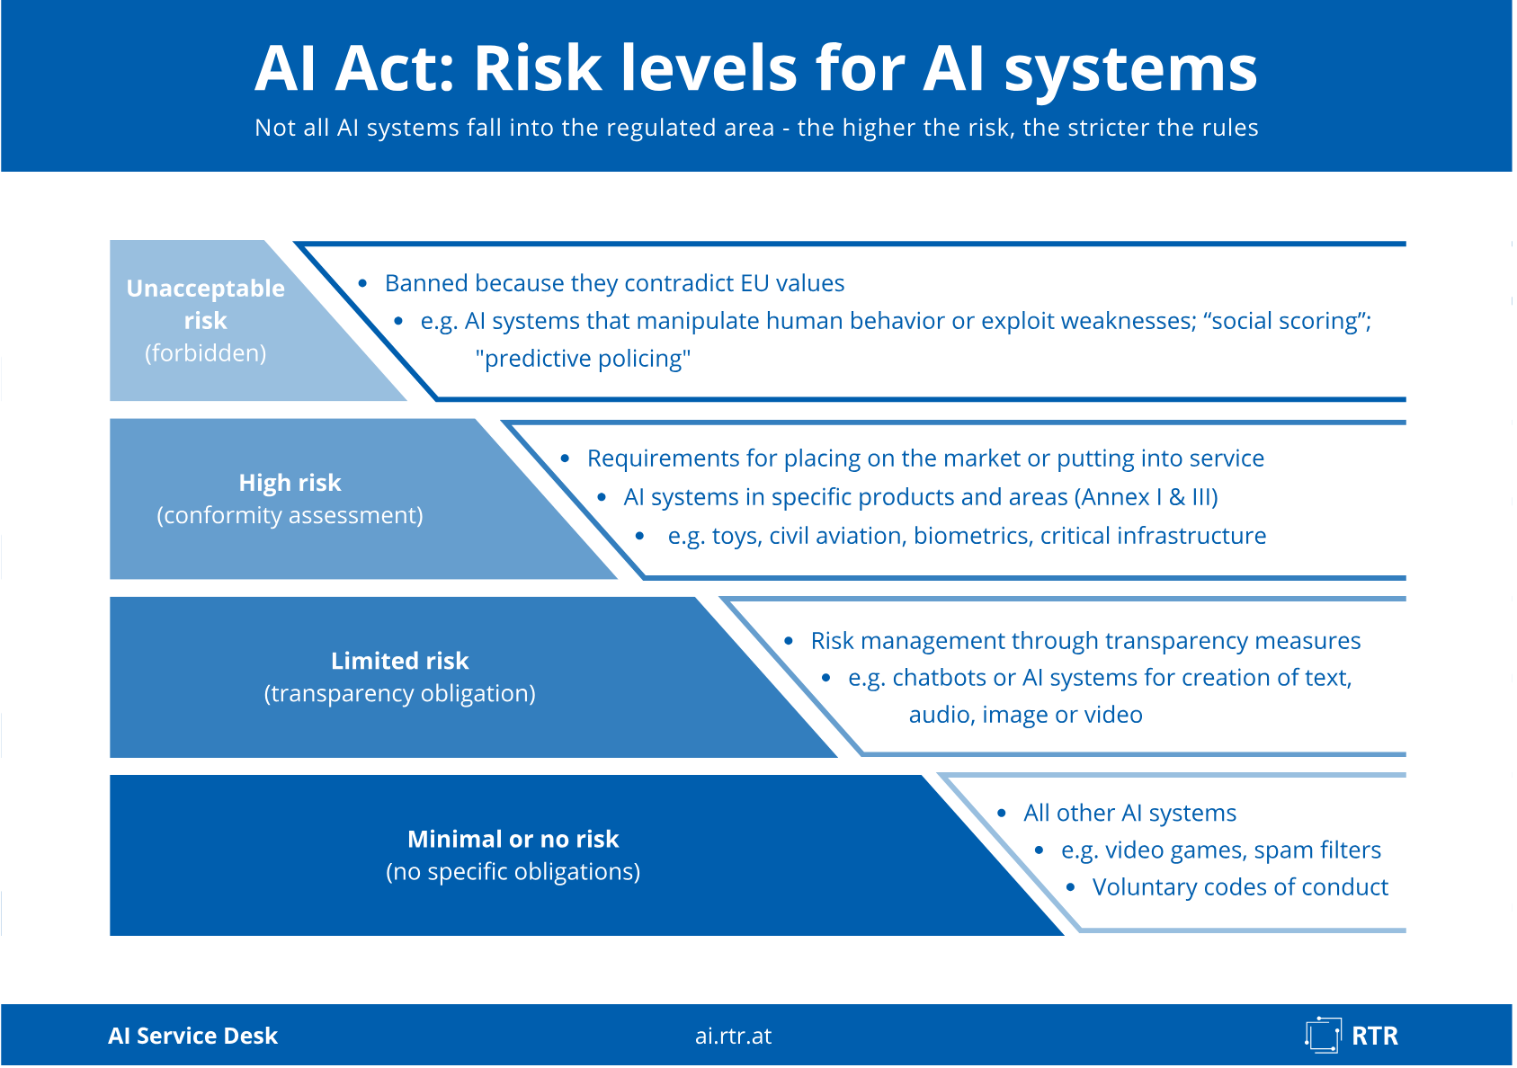
AI Act Risk Levels
Rundfunk und Telekom Regulierungs-GmbH (RTR-GmbH), Risk levels of AI systems, <https://www.rtr.at/rtr/service/ki-servicestelle/ai-act/risikostufen_ki-systeme.en.html>.

Slide 12
What does the AI-Act govern?

Slide 13
Prohibited AI Practices
Subliminal manipulation with considerable damage
Exploiting vulnerable groups of people
Social scoring with negative impact
Profiling to assess whether a crime will be committed
Creation of databases for facial recognition from images from the Internet
Emotion recognition in the workplace or in educational institutions
Biometric categorization to obtain sensitive data
Remote biometric identification (with strict exceptions for law enforcement purposes)
Art 5 AI Act.

Slide 14
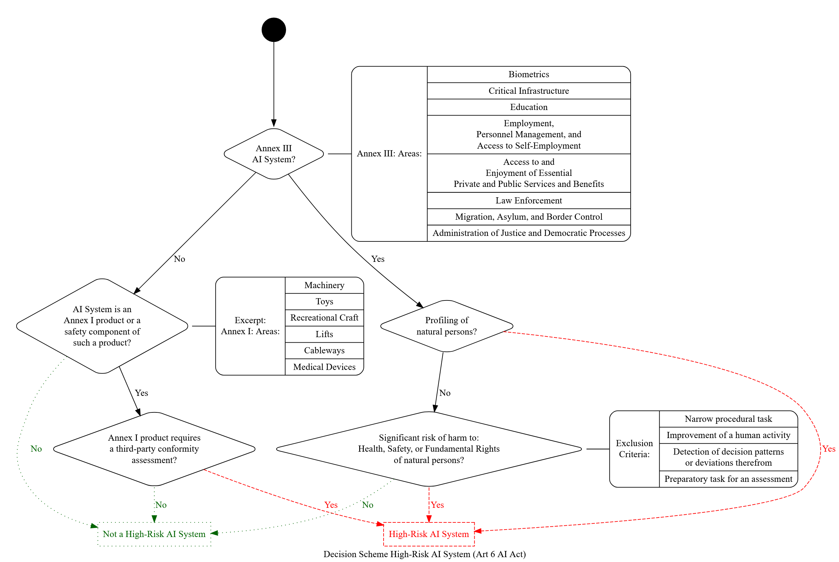
High-risk AI Systems
Art 6 AI Act.

Slide 15
AI Act Operators
Provider develops an AI system (general-purpose AI model) and
places it on the market / puts the AI system into service
Art 3 Sec 3 AI-Act.

Slide 16
AI Act Operators
Deployer
using an AI system under its authority
Art 3 Sec 4 AI-Act.

Slide 17
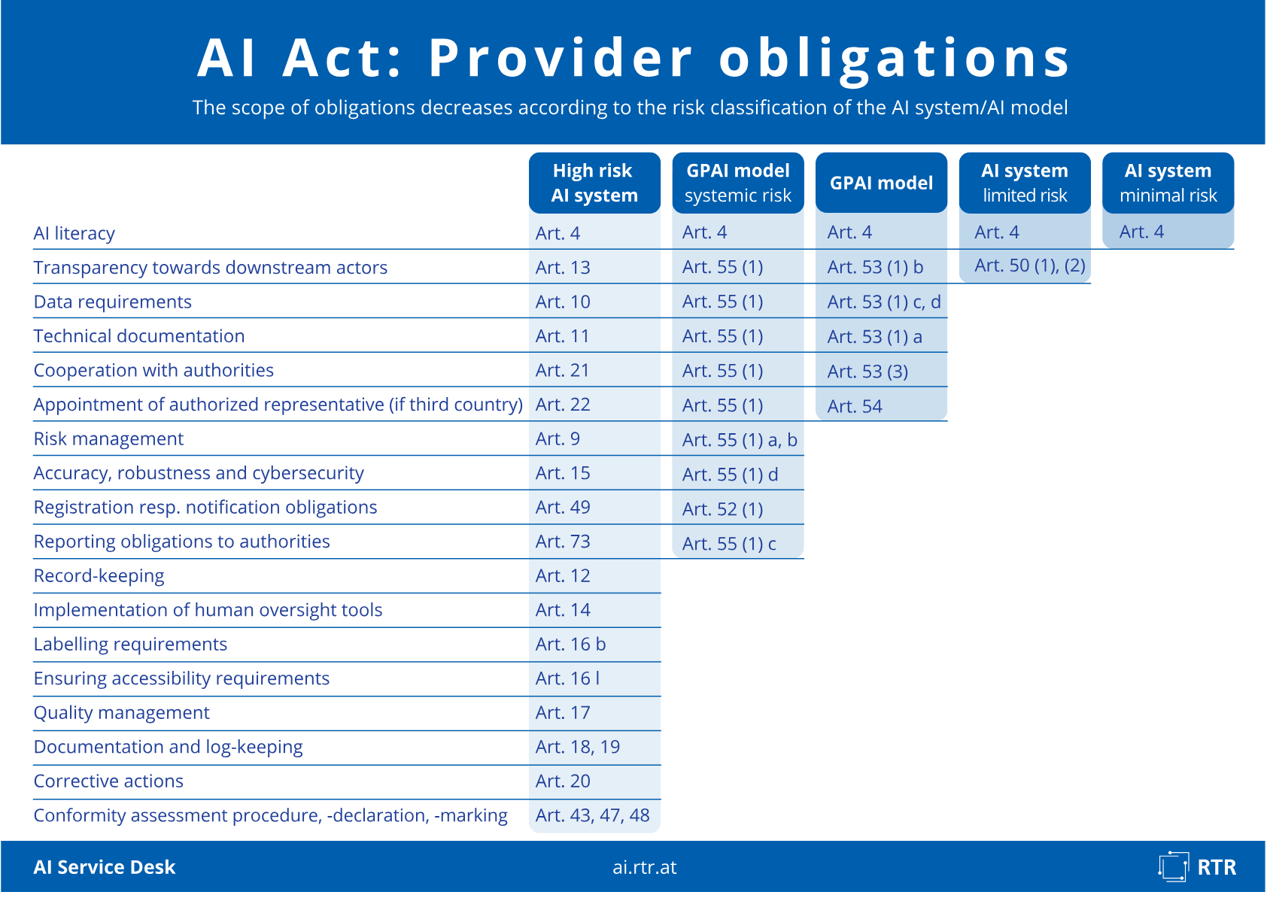
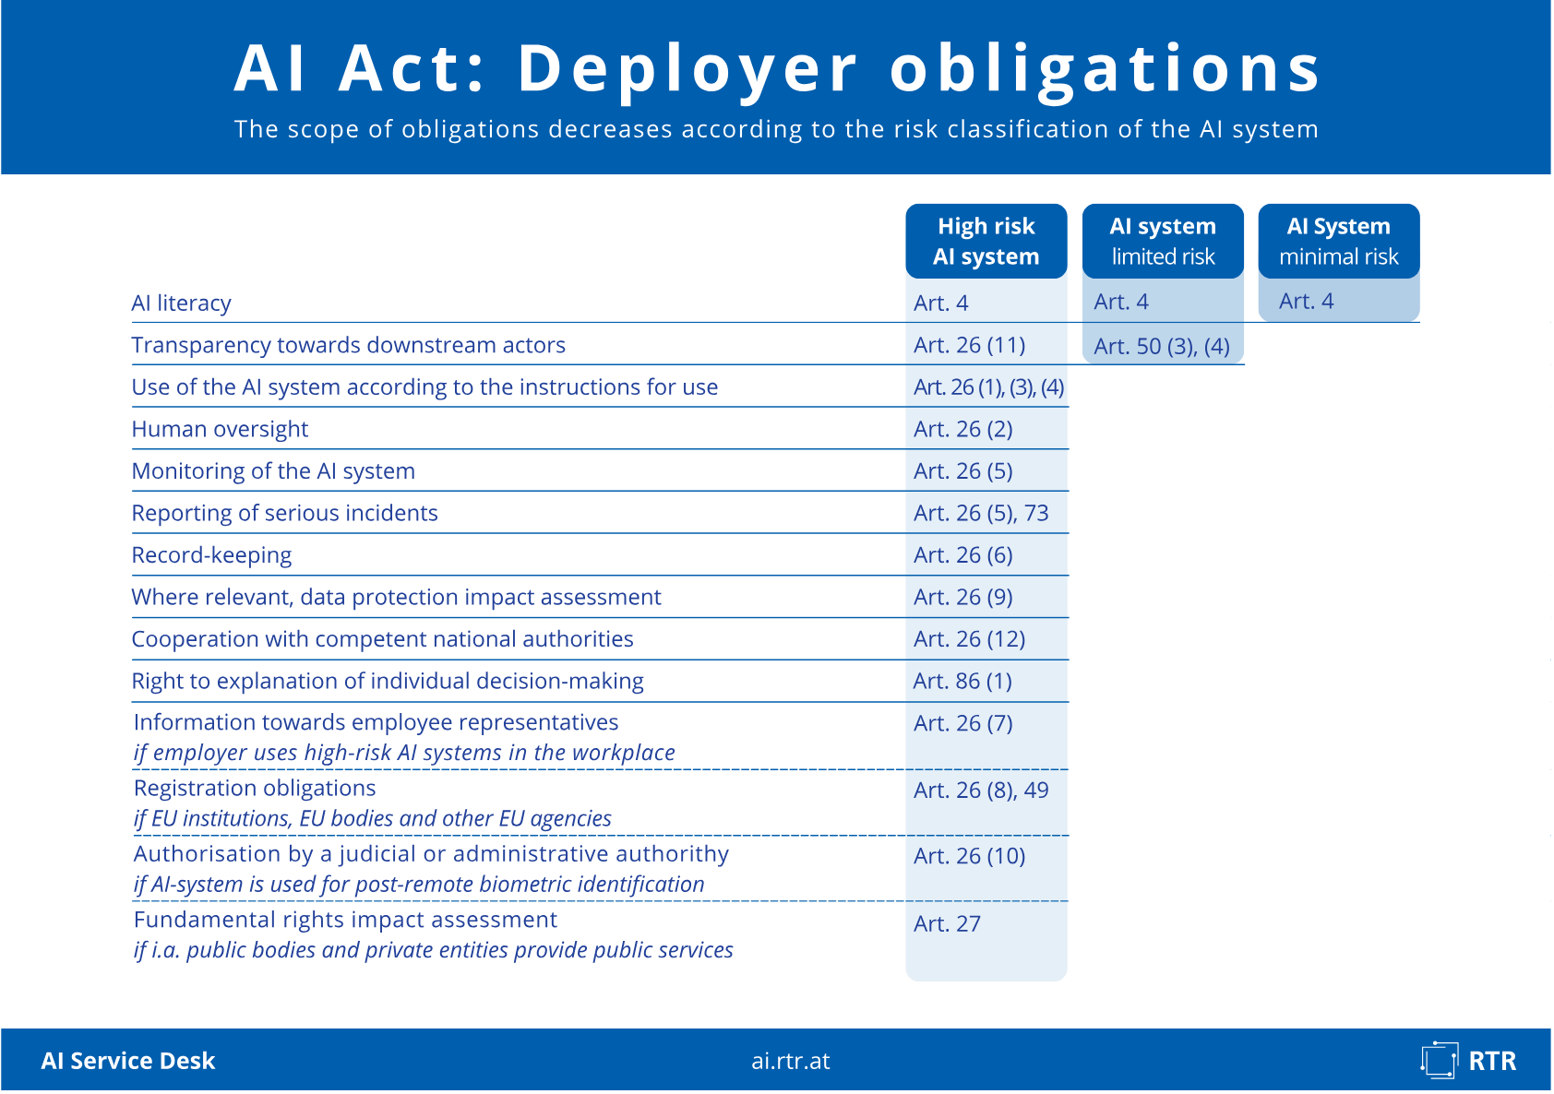
Obligations
Rundfunk und Telekom Regulierungs-GmbH (RTR-GmbH), Provider obligations in the AI Act, <https://www.rtr.at/rtr/service/ki-servicestelle/ai-act/Provider_obligations.en.html>.
Rundfunk und Telekom Regulierungs-GmbH (RTR-GmbH), AI Act: Deployer Obligations, <https://www.rtr.at/rtr/service/ki-servicestelle/ai-act/Deployer_obligations.en.html>.

Slide 18
When is the AI Act applicable?
02/2025:
Chapters I and II
08/2026: Most remaining rules, including transparency
08/2028: Annex I high-risk systems
08/2025: Chapters V, VII and XII (excluding Art 101), Chapter III Section 4, Art 78
12/2027: Annex III high-risk systems
Notes:
Updated for Regulation (EU) 2026/1744 (Digital Omnibus on AI).
Sources: Regulation (EU) 2024/1689, Article 113, as amended by Regulation (EU) 2026/1744; European Commission, AI Act implementation information (accessed 21 September 2026).

Slide 19
When is the AI Act applicable?
Date:
02/2025
08/2025
08/2026
12/2027
08/2028
Central rules (excerpt):
AI Literacy/Competence
Prohibitions
Governance
general-purpose AI models
- Most remaining rules, including transparency obligations
- Annex III high-risk AI systems: 12/2027
- Annex I high-risk AI systems: 08/2028
Notes:
The Digital Omnibus fixed new application dates for the core high-risk rules.
Source: Regulation (EU) 2024/1689, Article 113, as amended by Regulation (EU) 2026/1744.

Slide 20
Digital Omnibus on AI 2026 – Main Changes
1. Simplification
2. Governance
3. Innovation
Delayed obligations for high-risk AI
Reduced registration requirements
Simplified documentation burdens
Stronger AI Office mandate
More centralised oversight
Coordinated national enforcement
Expanded regulatory sandboxes
Real-world testing provisions
EU-level sandbox from 2028
Key changes include a delay of high-risk rules from 2026 to 2027–2028, a shift in AI literacy from obligation to encouragement, and standards increasingly functioning as governance instruments rather than mere technical tools.

Slide 21
Legal Landscape
Data Protection
Cyber Security
…
AI-Act
…
Private Law
Copyright Law
Product Liability
…
…
Fundamental
Rights
Criminal Law
…

Slide 22
Data Protection
“Data can be either useful or perfectly anonymous but never both.”¹
1:Ohm, Broken Promises of Privacy: Responding to the Surprising Failure of Anonymization, UCLA Law Review 2010, 1701.

Slide 23
Data Protection
Lawfulness
Purpose Limitation
Data Minimisation
Transparency
Documentation
Accountability
Data protection law is characterised by the prohibition principle
“Everything is forbidden unless it is exceptionally permitted.”

Slide 24
Legal Landscape
Data Protection
Cyber Security
…
AI-Act
…
Private Law
Copyright Law
Product Liability
…
…
Fundamental
Rights
Criminal Law
…
24

Slide 25
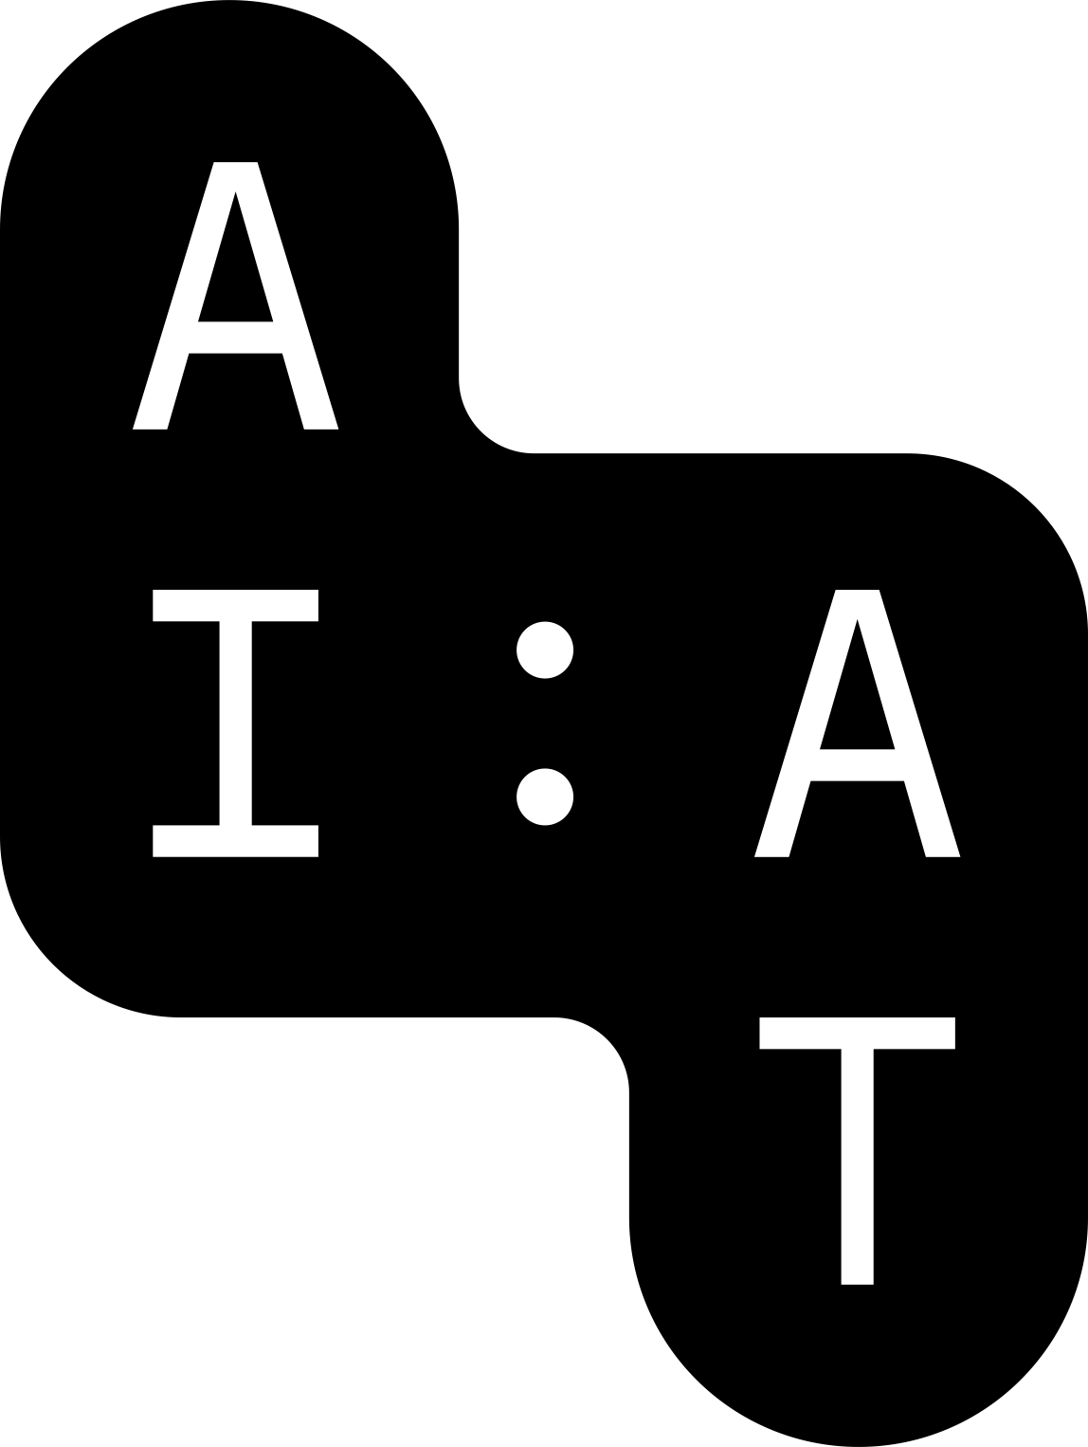
AI & Copyright – acts of use across the AI lifecycle
1. Ingestion & pre-processing
2. Training loop
3. Model artefact
5. Logs & caches
4. Generation & retrieval
collection, scraping, copying, normalisation
training iterations and internal processing
statistical representations / model weights
prompt processing and output generation
retention for improvement or further training
Different stages can implicate different rights: reproduction, extraction, database rights, communication to the public, adaptation and contractual restrictions.
25
AI Factory Austria AI:AT - PUBLIC
51
Notes:
Sources
- European Audiovisual Observatory, Copyright and AI training, 2026, section 3.1 and Figure 3.
- Rosati, E. (2025), The future of the movie industry in the wake of generative AI.

Slide 26
AI & Copyright: Main issues under EU law
Input side: training and datasets
Output side: generated content
• AI training normally involves copyright-relevant reproductions/extractions
• Articles 3 and 4 CDSM may provide a legal basis if conditions are met
• It remains contested whether they cover all copyright-relevant acts across a complete GenAI training pipeline
• Article 4 requires lawful access and respect for rights reservations
• AI Act adds GPAI copyright-policy and training-summary duties
• Copyright remains based on human authorship
• AI-assisted works may be protected if humans shape protected expression
• Prompting alone will normally not establish authorship
• Outputs without human authorship may still infringe existing rights
26
AI Factory Austria AI:AT - PUBLIC
52
Notes:
Sources
- European Audiovisual Observatory, Copyright and AI training, 2026, Main takeaways.
- AICopyright_Primer_1 and Primer_2 revised update notes.
- Regulation (EU) 2024/1689, Article 53.

Slide 27
Take-aways
1. Input
2. Compliance
AI training involves copyright-relevant acts. Arts. 3 and 4 CDSM can provide exceptions for TDM (Text Data Mining), but their application to all stages of GenAI training remains contested.
For GPAI providers, the AI Act adds duties concerning copyright policy, rights reservations and transparency about training content.
3. Output
4. Infringement
Copyright remains based on human authorship and human creative control. AI assistance does not exclude protection, but prompting alone will not automatically establish authorship.
Output protection and output infringement are separate questions. Litigation highlights memorisation and recognisable reproduction of protected expression.
27
AI Factory Austria AI:AT - PUBLIC
66
Notes:
Sources
- European Audiovisual Observatory, Copyright and AI training, 2026, Main takeaways.
- Regulation (EU) 2024/1689, Article 53.
- LG München I, judgment of 31 July 2026, 42 O 763/25, GEMA v Suno.

Slide 28
Key takeaways
The use of AI Systems and models within the European Union is governed - by different
legal frameworks
The AI Act is one of the most relevant regulations
Providers and Deployers of AI should (at least) also be aware of Data Protection and Copyright aspects
28

Slide 29
Trustworthy AI:
The role of AI ethics

Slide 30
Introduction
Why must AI be “Trustworthy”?
Dim your lights
Chatting companion
Automate business functions
Build code
Notes:
Rodrigo

Slide 31
Introduction
Why must AI be “Trustworthy”?
High energy use
Misuse of personal information
Single out employees
Bugs that are harder to find/counter
Notes:
Rodrigo

Slide 32
Trustworthy AI
Developing AI that is…
Safe
Reliable
Transparent
Fair
Aligned with societal values
Notes:
Rodrigo

Slide 33
Trustworthy AI: A European Strategy
Trustworthy AI is in the EU context
a governance approach
an innovation policy strategy
a way of translating & institutionalising democratic & public-interest goals into the development, deployment, & governance of AI
a way to retain the capacity to shape the conditions under which AI is developed, deployed, and governed
a way to retain societal & democratic agency over increasingly powerful and infrastructure-shaping AI systems
Trustworthy AI translates public values into:
Trustworthy AI concerns:
Trustworthy AI connects:
  technical design choices
  AI Architecture
  development practices
  organisational responsibilities
  the entire AI lifecycle
  the actors involved
  the infrastructures used
  and the institutional contexts in which AI systems operate
  technological innovation
  regulation
  ethics
  governance
  and societal legitimacy
Notes:
Co

Slide 34
Through a human-centered approach to AI
“Artificial intelligence should treat all people fairly, empower everyone, perform reliably and safely, be understandable, be secure and respect privacy, and have algorithmic accountability. It should be aligned with existing human values, be explainable, be fair, and respect user data rights. It should be used for socially beneficial purposes and always remain under meaningful human control.”
Tom Chatfield (2020). There’s No Such Thing As Ethical AI.
AI ethics refers to moral principles and values that should guide the development and use of AI systems.
Notes:
Co

Slide 35
The fundamental role of ethics in decision-making in AI
Ethics provides orientation beyond legal requirements: Law does not address all societal implications and normative challenges of AI
  Law establishes whether an AI use is legally permissible, beyond that ethics helps assess whether it is desirable, appropriate and acceptable in a particular context (Broadens the perspective: for whom? What consequences?)
  Legal rules necessarily operationalise only some dimensions of ethical values ethics helps examine what may be missing from a legally compliant solution
  AI evolves faster than regulation. Ethics helps identify and deliberate on emerging issues before legal requirements or interpretations are established
Ethics provides normative orientation for decision-making
  Decision-making support: deciding between what is right and wrong and makes values and
  trade-offs explicit
  Basis: rights, obligations, welfare of society, virtues, utility, etc.
  Describe the quality of a decision, including individual and wider consequences
Ethics helps anticipate and prevent harm
  Identifies potential harms and asks who may be affected, including indirect, cumulative or broader societal impacts
  Humans using AI → How to better exercise “ethics” while using AI
  For AI → Embed ethics in automated decision-making
Rozgonyi, Krisztina, Mari-Liisa Parder, and Rodrigo Conde Jiménez. "Ethics in Regulating Artificial Intelligence: An Overview of the Recent Legislation in the European Union." Genealogy+Critique 12, no. 1 (2026): 1–36. DOI: https://doi.org/10.16995/gc.25624
Notes:
Ro

Slide 36
Why is this important?
Definition: Framework for desirable outcomes: law is the bare minimum, ethics → specific expectations
Objective: Build trust, minimize risks, and maximize social benefits
Practical relevance: Point of reference for regulation, research, and industrial application
Distinction: Desirable standard for “norms of conduct” beyond just legal compliance
Social dimension: Consideration of long-term effects on democracy, professinal life, and the environment
Dynamics: Ethics is always in constant dialogue with the latest advances of technology
Notes:
Ro

Slide 37
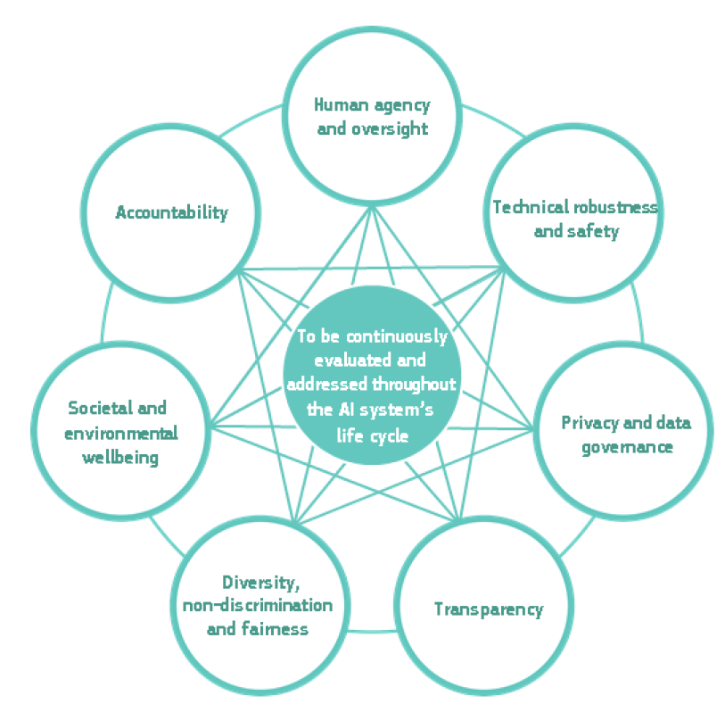
Ethical principles according to the High-Level Expert Group on Artificial Intelligence
Notes:
Rodrigo

Slide 38
Who makes AI trustworthy in practice?
Trustworthy AI is a distributed responsibility across the AI lifecycle. Different actors must provide different systemic capabilities to shape whether ethical and public-interest principles are translated into concrete technologies, organisational practices and use contexts
Developers
Translate principles into design choices, data practices, testing, documentation and technical safeguards
Providers
Establish governance, risk management, transparency, accountability, human oversight and monitoring around AI systems
Deployers
Decide how AI is embedded in organisational contexts, ensure appropriate use, human oversight and contextual risk management
Users
Exercise human agency in interaction with AI, critically assess outputs, use systems within intended boundaries & report problems
Start-ups /SMEs → Particularly important; Can act simultaneously as developers, providers & deployers
Scaling AI through markets and industrial ecosystems
Embedding AI into infrastructures, value chains and work practices, product, architecture & business-model decisions
Can build (trustworthy) AI ecosystems, shape technological trajectories,→ contribute to Europe's sovereignty
Develop personal capabilities via AI literarcy
Notes:
Co Trustworthy AI is not implemented by one actor alone. It emerges through a chain of decisions across the AI lifecycle. Developers shape technical choices, providers establish governance and accountability structures, deployers determine how systems are embedded in real organisational contexts, and users influence how AI is actually used in practice. Start-ups are particularly interesting because they often combine several of these roles and can therefore shape products, business models and technological trajectories at a very early stage. The key point is that responsibility is distributed, but not identical: different actors have different capacities to act and therefore different responsibilities. AI Factories explicitly position start-ups and SMEs as target groups for access to computing infrastructure and data, making them active participants in Europe’s AI capacity-building and strengthen the ecosystem

Slide 39
Ethics as enabler of trustworthy AI
Ethics is complex and remains important
  There are many unanswered questions, AI law and ethics are dynamic, continuously evolving fields navigating ongoing technical innovation : we are in the midst of a journey, not at its end
Current AI systems reflect human choices, data, values, institutional practices and societal inequalities
  Many questions therefore cannot be resolved technologically alone
Ethical questions arise throughout the AI lifecycle and evolve with technologies and use contexts
  Different roles, different leverage points → shared responsibility for trustworthy AI
Role of the AI Factory Ethics Team
  Provides support for questions regarding AI ethics
  Develops frameworks and guidelines for trustworthy / responsible AI
  Supports stakeholders in developing and deploying trustworthy / responsible AI systems
Notes:
Co

Slide 40
Why do we need AI Factory Austria?
Sovereignty
Ethics and Trustworthiness
Connecting the Ecosystem
Notes:
Ro

Slide 41





Q & A
Funded by
under discussion with
AI Factory Austria AI:AT - PUBLIC has received funding from the European High-Performance Computing Joint Undertaking (JU) under grant agreement
No 101253078. The JU receives support from the Horizon Europe Programm of the European Union and Austria (BMIMI / FFG).
41
AI Factory Austria AI:AT - PUBLIC

Slide 42

Contact
Rodrigo Conde-Jimenez
Cornelia Reiter
Scientists Legal, Regulatory and Ethics
AI Factory Austria AI:AT
rodrigo.conde-jimenez@ai.at.eu
cornelia.reiter@ai-at.eu
Krisztina Rozgonyi
Senior Scientist, Legal, Regulatory and Ethics
AI Factory Austria AI:AT
krisztina.rozgonyi@ai-at.eu
AI Factory Austria AI:AT
Schwarzenbergplatz 2
1010 Wien, Austria
info@ai-at.eu
ai-at.eu
@ai-factory-austria

